Slide 1
LPO 7870 Review 3

Slide 2
Course Content Questions?

Slide 3
Agenda
Course Content - Lectures 4 and 5
Omitted Variable Bias
Heteroskedasticity
R-squared
Multiple Regression
Multiple Hypothesis Testing
Assignment 2 Questions

Slide 4
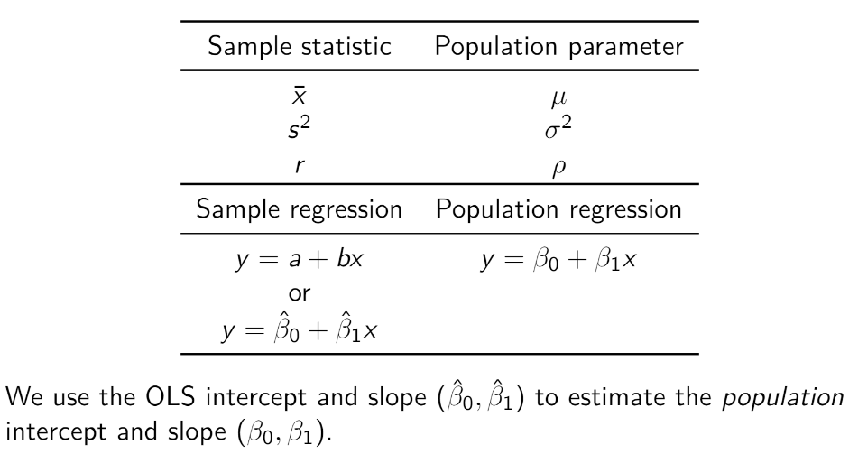
Introduction to Inference

Slide 5
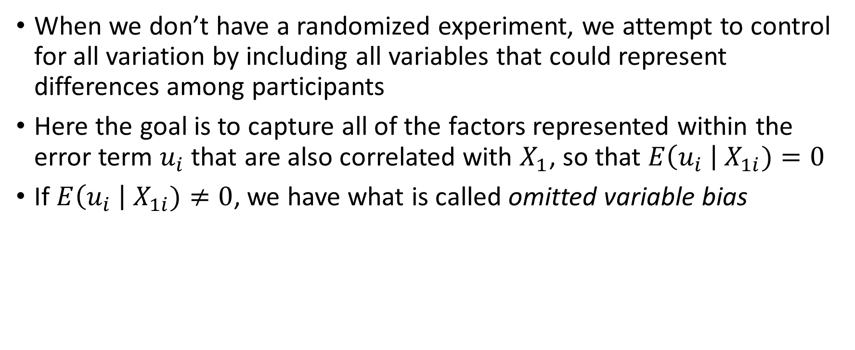
Omitted Variable Bias
When we don’t have a randomized experiment, we attempt to control for all variation by including all variables that could represent differences among participants
Here the goal is to capture all of the factors represented within the error term $u_{i}$ that are also correlated with $X_{1}$, so that $E\left(u_{i} \right| X_{1i})=0$
If $E\left(u_{i} \right| X_{1i})≠0$, we have what is called omitted variable bias

Slide 6
Example
Imagine we have a school which is comparing student test scores across discipline. They find that students, in general, get lower scores in math. The school then starts replacing their math teachers.
Given only this information, would you assume this variation is because of the math teachers?
What omitted variables might change the way we consider student test scores in math?

Slide 7
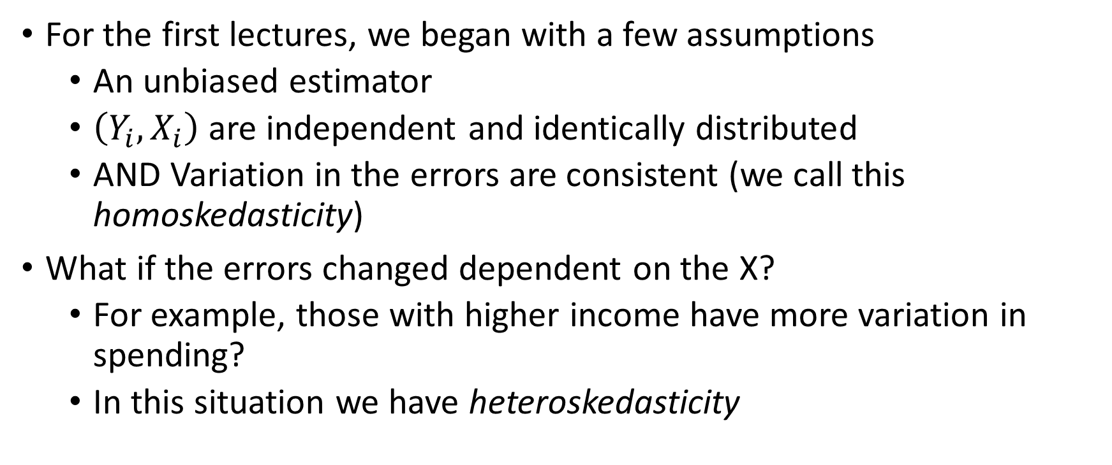
Heteroskedasticity
For the first lectures, we began with a few assumptions
An unbiased estimator
$\left(Y_{i}, X_{i}\right)$ are independent and identically distributed
AND Variation in the errors are consistent (we call this homoskedasticity)
What if the errors changed dependent on the X?
For example, those with higher income have more variation in spending?
In this situation we have heteroskedasticity

Slide 8
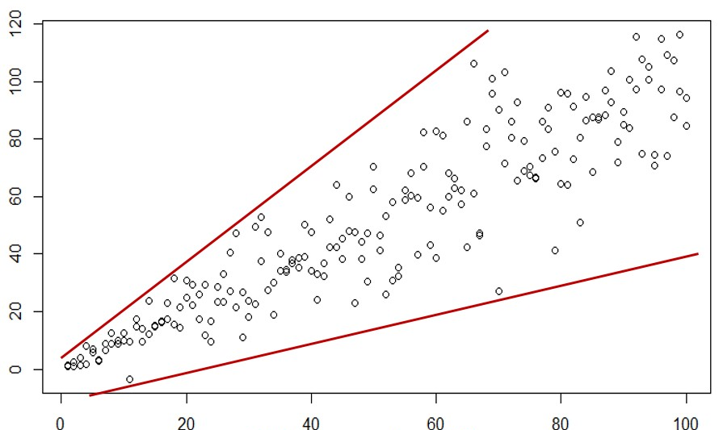

Slide 9
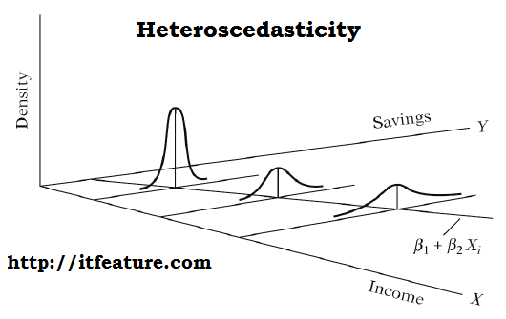

Slide 10
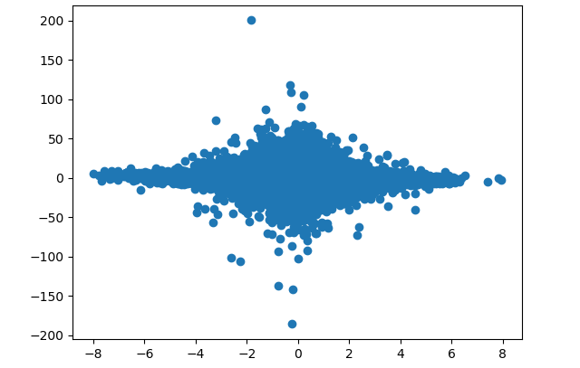
Practice: Homoskedastic or Heteroskedastic?

Slide 11
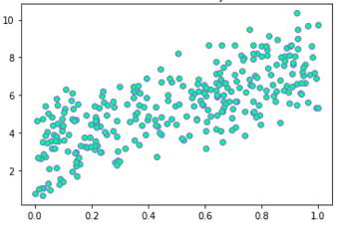
Practice: Homoskedastic or Heteroskedastic?

Slide 12
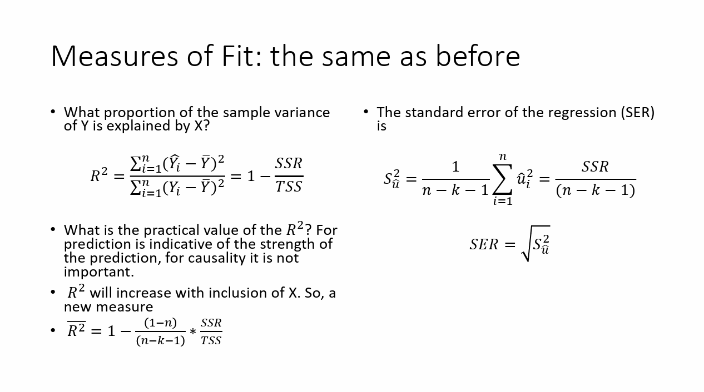
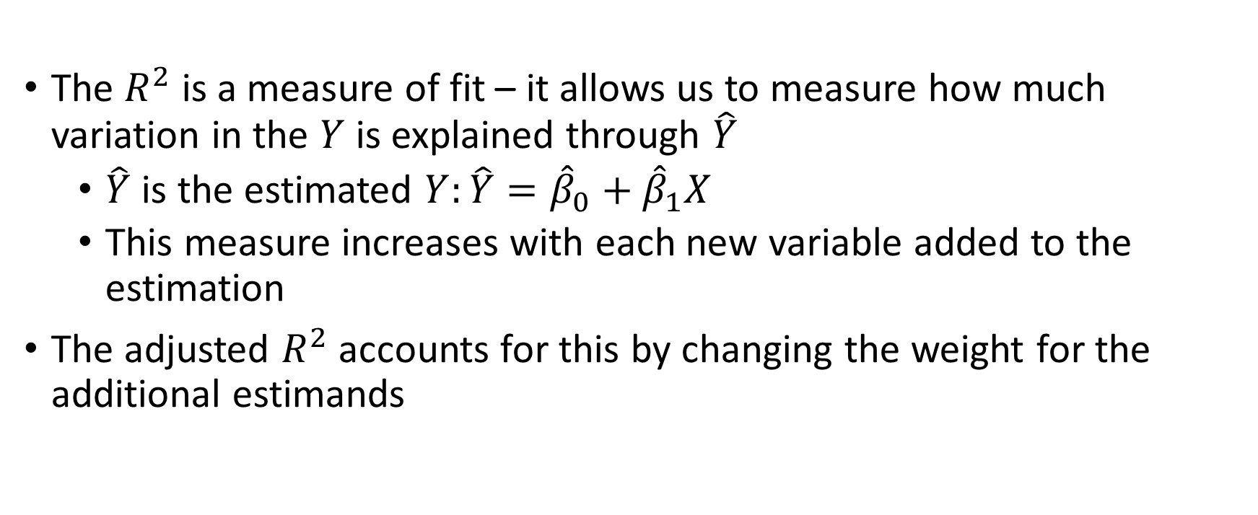
R-squared and Adjusted R-squared
The $R^{2}$ is a measure of fit – it allows us to measure how much variation in the $Y$ is explained through $\hat{Y}$
$\hat{Y}$ is the estimated $Y:\hat{Y}={\hat{β}}_{0}+{\hat{β}}_{1}X$
This measure increases with each new variable added to the estimation
The adjusted $R^{2}$ accounts for this by changing the weight for the additional estimands

Slide 13
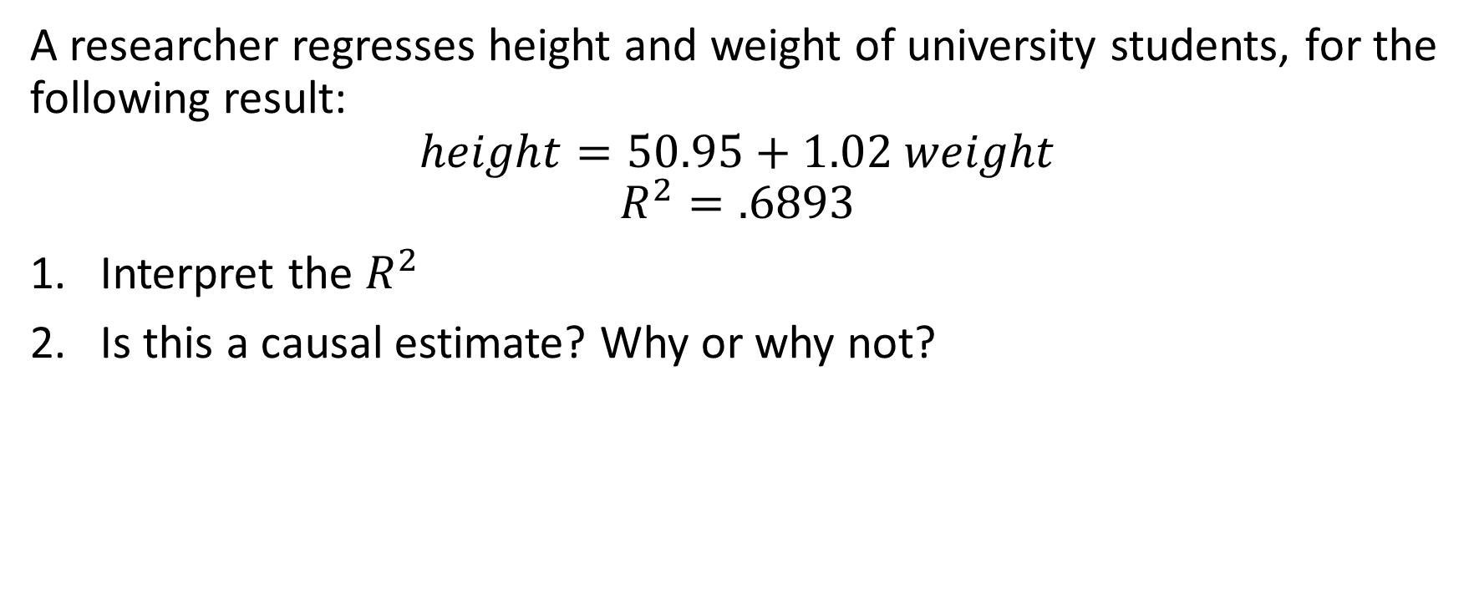
Example
A researcher regresses height and weight of university students, for the following result:
$$height=50.95+1.02 weight$$
$$R^{2}=.6893$$
Interpret the $R^{2}$
Is this a causal estimate? Why or why not?

Slide 14
Multiple Regression

Slide 15
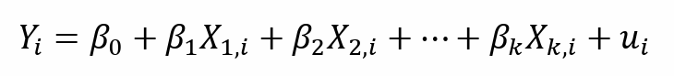
Multiple Regression Model

Slide 16
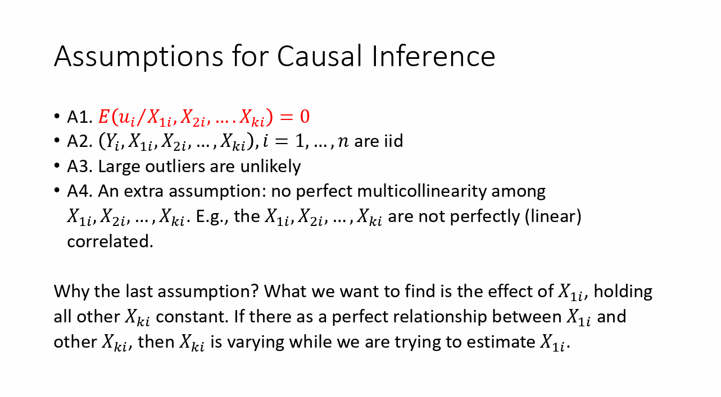

Slide 17

Multiple Regression Interpretation
Each slope coefficient is interpreted as the partial effect of that x on y holding all other explanatory variables constant.
Ex: $β_{1}$ is the predicted change in y for a one-unit change in $x_{1}$, holding $x_{2}$ constant.

Slide 18
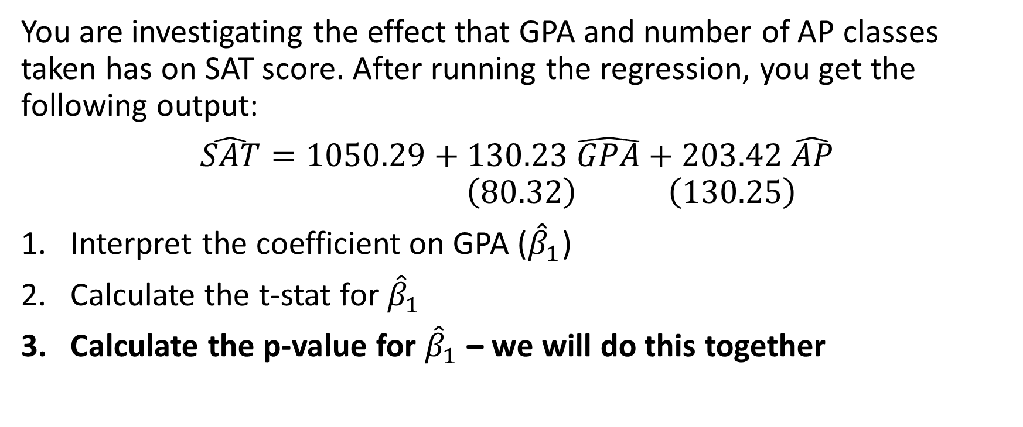
Practice
You are investigating the effect that GPA and number of AP classes taken has on SAT score. After running the regression, you get the following output:
$$\hat{SAT}=1050.29+130.23 \hat{GPA}+203.42 \hat{AP}$$
$$\left(80.32\right) \left(130.25\right)$$
Interpret the coefficient on GPA (${\hat{β}}_{1}$)
Calculate the t-stat for ${\hat{β}}_{1}$
Calculate the p-value for ${\hat{β}}_{1}$ – we will do this together

Slide 19
P-Value Table
statsexamples-table-normal.jpg (2160×2880)

Slide 20
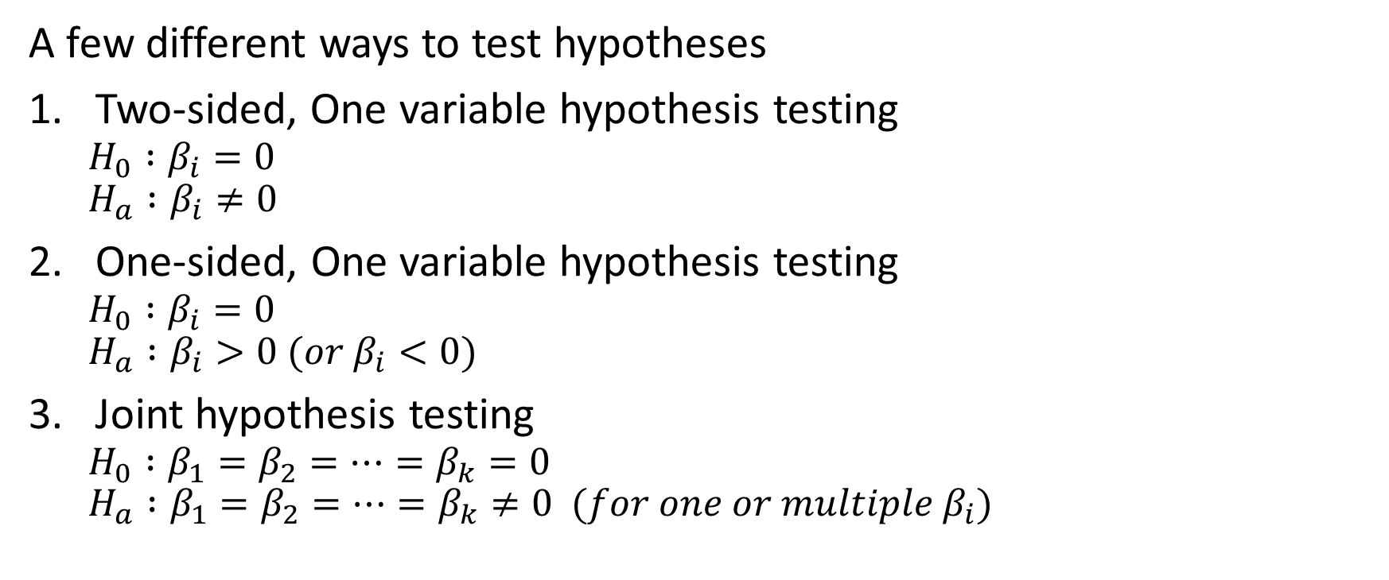
Multiple Hypothesis Testing
A few different ways to test hypotheses
Two-sided, One variable hypothesis testing
$$H_{0} :β_{i}=0 \\ H_{a} :β_{i}≠0$$
One-sided, One variable hypothesis testing
$$H_{0} :β_{i}=0 \\ H_{a} :β_{i}>0 (or β_{i}<0)$$
Joint hypothesis testing
$$H_{0} :β_{1}=β_{2}=…=β_{k}=0 \\ H_{a} :β_{1}=β_{2}=…=β_{k}≠0 (for one or multiple β_{i})$$

Slide 21
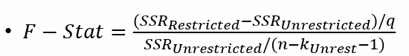
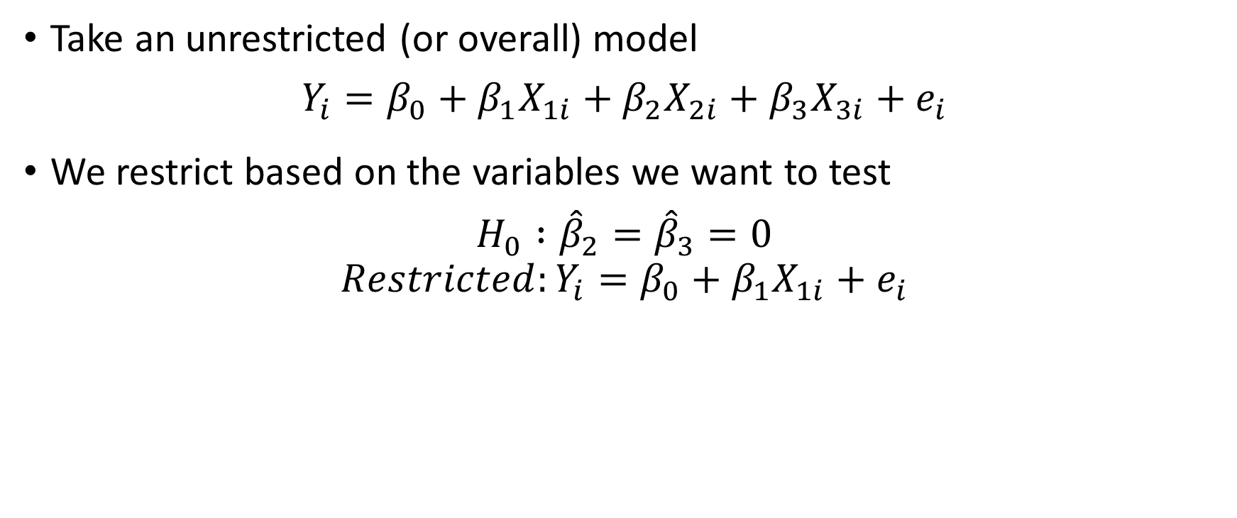
Joint Hypothesis Testing (assuming homoskedasticity)
Take an unrestricted (or overall) model
$$Y_{i}=β_{0}+β_{1}X_{1i}+β_{2}X_{2i}+β_{3}X_{3i}+e_{i}$$
We restrict based on the variables we want to test
$$H_{0} :{\hat{β}}_{2}={\hat{β}}_{3}=0$$
$$Restricted:Y_{i}=β_{0}+β_{1}X_{1i}+e_{i}$$

Slide 22
Practice
Imagine you want to see the impact that a range of policies have on test scores. These policies may include school enrollment caps, class size caps, and units needed for graduation.
Write out the population multiple regression model
Let’s say you would like to jointly analyze school enrollment caps and class size caps. Write out the null hypothesis as well as the restricted and unrestricted models.

Slide 23
Upcoming Review Sessions
Feb 29 - Review for Mid-Term and help on PS 3
Mar 7 - Session to Review Mid-Term Answers
Mar 28 - Help session for PS 4 due Apr 1
Apr 11 - Help session for PS 5 due Apr 15
(?) Apr 18 - Final Project support

Slide 24
Office Hours
Felipe
Office: Payne Hall 106C
Time: Mondays, 2:00-4:00pm
Kathryn
Office: Payne Hall 011A
Time: Tuesdays, 1:00-3:00pm
Sean
Office: Payne Hall 205C
Time: Wednesdays, 9:00-11:00am
Sara
Office: Payne Hall 107
Time: Thursdays, 3:00-5:00pm

Slide 25
Questions?

